Slide 1
Ticket Management System using Queue
A practical implementation of data structures and algorithms in C++

Slide 2
Introduction to Ticket Systems
Ticket systems are fundamental in service-based environments worldwide, ensuring fair and orderly processing of customers or tasks. They prevent confusion, reduce overcrowding, and maintain operational sequence.
The queue data structure perfectly models this real-world scenario, maintaining the natural order of customer arrivals and service requirements.
System Design
FIFO Principle
Design an efficient customer flow management system using queue data structure
Understand First-In-First-Out principle through hands-on implementation
DSA Application
C++ Programming
Apply data structures and algorithms concepts to real-world scenarios
Build a menu-driven program with practical coding skills
Notes:
• Start by explaining what ticket systems are—they're used everywhere: banks, hospitals, DMV, customer service centers • Key benefits: fairness (first come, first served), reduces chaos and overcrowding, keeps things organized • Transition to the connection with queues: a ticket system is a perfect real-world example of how a queue data structure works • Emphasize that queues maintain order—customers arrive, get a ticket, and are served in sequence • This is why we're learning about queues: they solve actual problems we see in everyday life

Slide 3
Complexity & Array
Complexity analysis is used to measure the efficiency of an algorithm in terms of time and space using Big-O notation, while an array is a linear data structure that stores elements of the same type in contiguous memory and allows fast access using index positions.
int arr[3] = {10, 20, 30};
for(int i = 0; i < 3; i++)
{ cout << arr[i];
// O(n)}
Linked List - Stack
A linked list is a dynamic data structure where elements are stored in nodes connected by pointers, allowing flexible memory usage, while a stack is a linear data structure that follows the LIFO (Last In First Out) principle where elements are inserted and removed using push and pop operations.
struct Node { int data; Node* next; };
stack s;
s.push(10);
s.pop();
Notes:
• We have four key learning objectives for this session
• System Design – We'll create an efficient customer flow management system using queue data structure. This teaches you how to solve real-world problems with the right data structure.
• FIFO Principle – You'll understand and implement the First-In-First-Out principle hands-on. This is fundamental to how queues work.
• DSA Application – We're taking data structures and algorithms concepts from theory and applying them to a practical, real-world scenario you can relate to.
• C++ Programming – By the end, you'll have built a complete menu-driven program that brings all these concepts together with solid coding practices.

Slide 4
Queue & Sorting
A queue is a linear data structure that follows the FIFO (First In First Out) principle where elements are inserted at the rear and removed from the front, while sorting is the process of arranging data in a specific order such as ascending or descending to make searching and processing more efficient.
Queue Data Structure
FIFO Principle
Insertion & Deletion
Linear data structure where elements follow First-In-First-Out order
Elements added at rear position, removed from front position
Key Operations
Efficiency
push(), pop(), front(), empty() methods
O(1) time complexity for insertion and deletion operations

Slide 5
Searching - Tree
Searching is the process of finding a specific element in a dataset using techniques like linear or binary search, while a tree is a hierarchical data structure consisting of nodes with parent-child relationships, commonly used to represent structured data.
for(int i = 0; i < n; i++)
if(arr[i] == key)
return i;
struct Node { int data; Node* left; Node* right; };
Graph & Hashing
A graph is a data structure consisting of vertices and edges used to represent relationships such as networks, while hashing is a technique that maps keys to values using a hash function, allowing fast data access and retrieval.

Slide 6

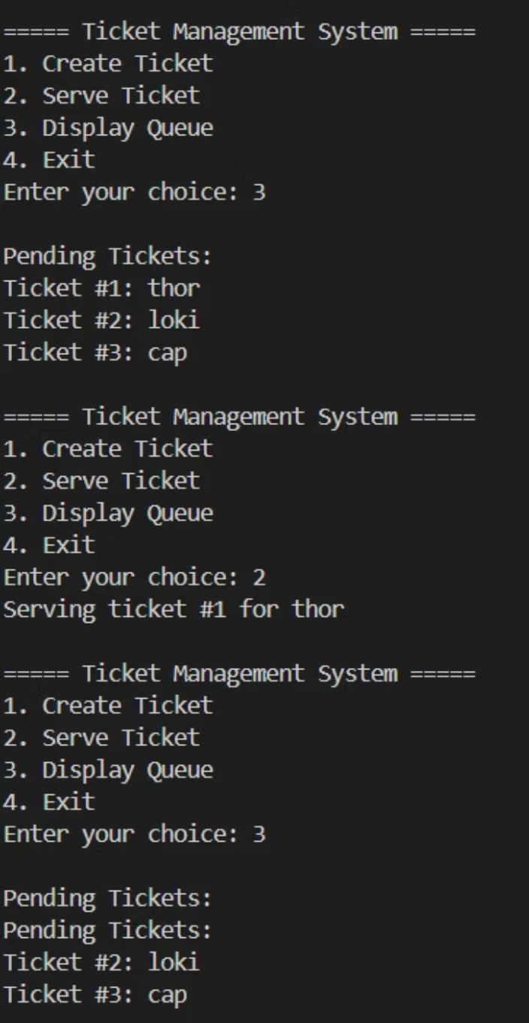



How the System Works
User Selection
Real-World Applications
Customer or operator selects an option from the menu interface
Ticket Creation
Bank Token Systems
New ticket is generated and added to the queue's rear position
Manages customer queue at banking counters, ensuring fair service order
Service Processing
Front ticket is removed from queue and served to customer
Hospital Patient Management
Organizes patient appointments and emergency room queues efficiently
Queue Display
All pending tickets shown in sequential order for transparency
Customer Support
Handles support ticket requests in order of arrival for technical assistance
Printer Job Scheduling
Manages print jobs queue in computer systems for orderly processing
——————————— OUTPUT ———————————

Slide 7


Objective
Outcome
The objective of this project is to implement a ticket management system using queue data structure in C++ to ensure fair and efficient processing of customers following the FIFO principle.
The outcome of this project is a working system that successfully manages customer tickets using queue operations, demonstrating the practical application of DSA concepts in real-world scenarios

